Slide 1
Group 03 Study Buddy
Anika Siddiqui Mayesha
Rumaysa Babulkhair (Team Lead)
Yurii Sykal
Lorenzo Palleschi

Slide 2
Agenda
Feature plan
Survey methods
Logo Evaluation
System Updates

Slide 3

Feature plan

Slide 4
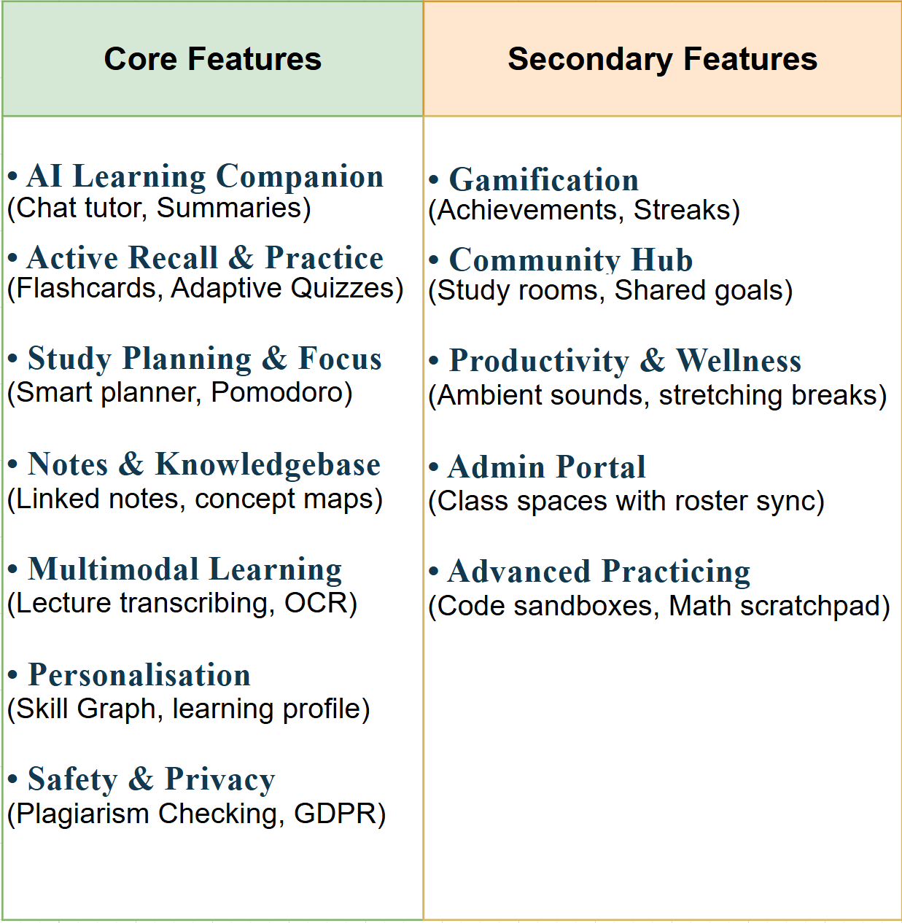

Slide 5

Survey Methods

Slide 6

Why we evaluate
• Usability Analysis
• Learning impacts
• Motivations
• Behavioural changes
Est participants ~15-25 undergrad / postgrad

Slide 7
How we’ll evaluate
• Questionnaires / Surveys
• Shadowing / Think-Aloud
• Potentially fidelity prototypes
• Draw me how you think it should look
Notes:
Various methodologies

Slide 8
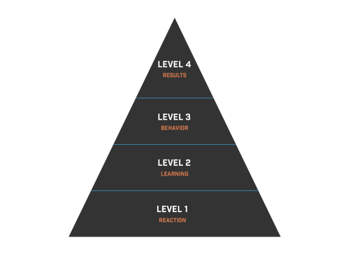
How we’ll evaluate (models)
Direct result measuring
Behavioural analysis to ensure skills were understood
Gauge learning to see how they acquire the desired knowledge
Do learners find it engaging?
Kirkpatrick Model
Notes:
Various testing models, & System Usability Scale (SUS)

Slide 9
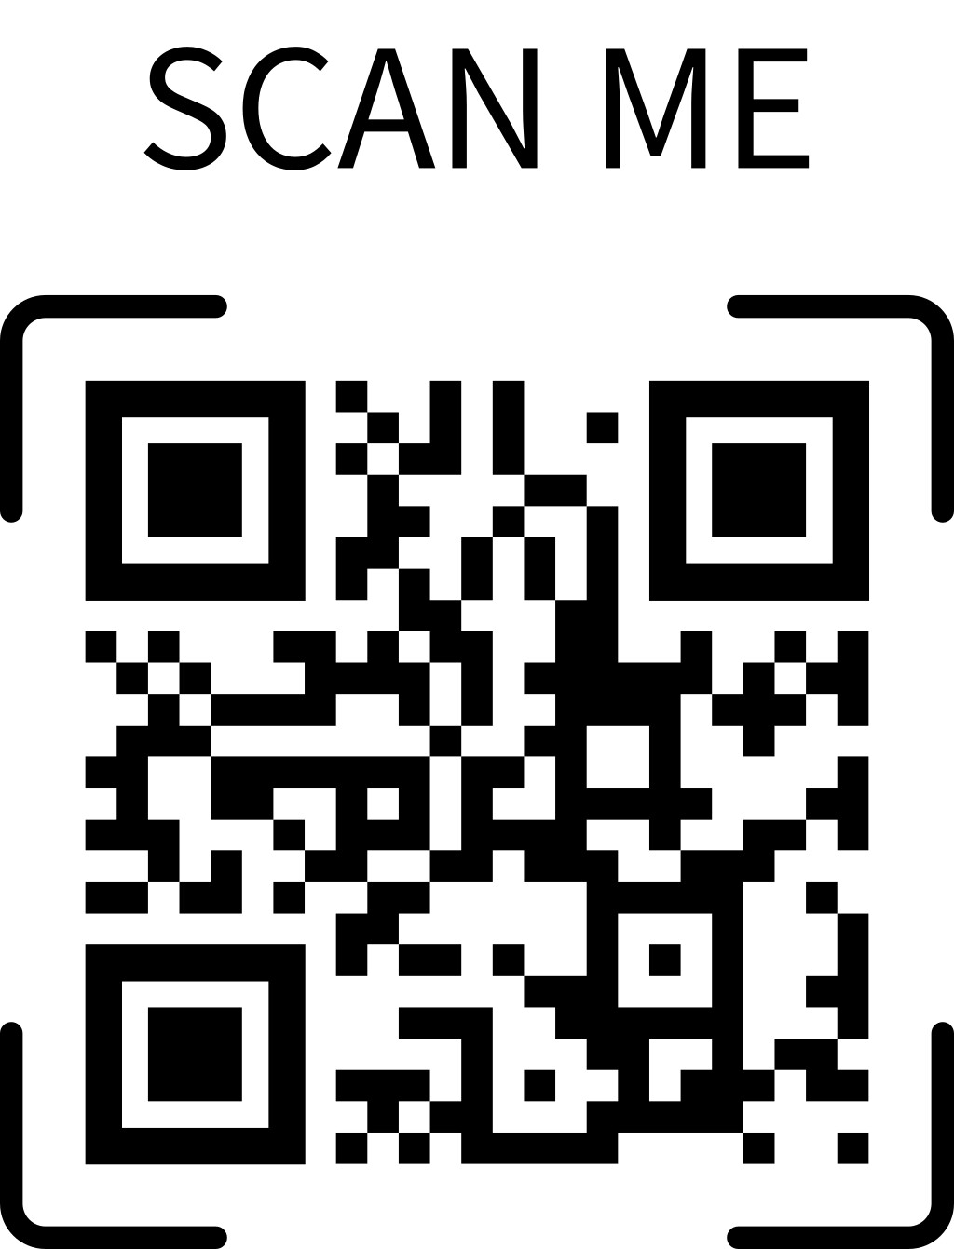
Logo Design Evaluation

Slide 10

Logo Design 1

Slide 11

Logo Design II

Slide 12

Logo Design III

Slide 13

Logo Design VI

Slide 14
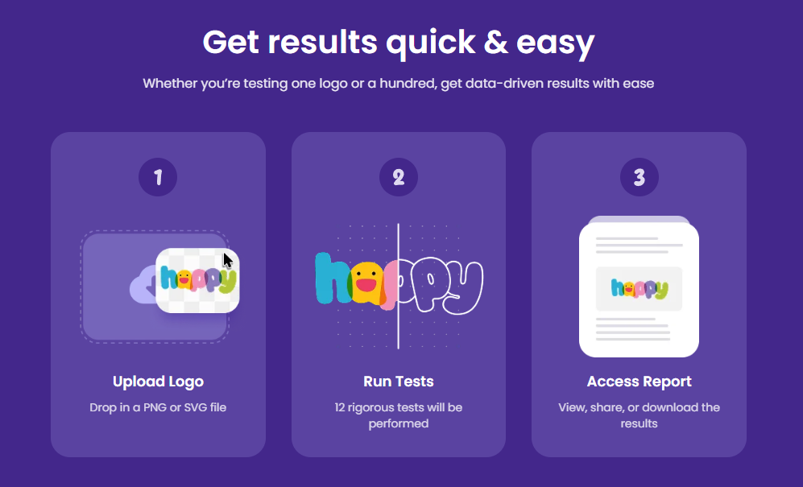
Logo Lab
Notes:
Professional testing

Slide 15
Attention insight
Notes:
Heatmaps

Slide 16
System Updates

Slide 17
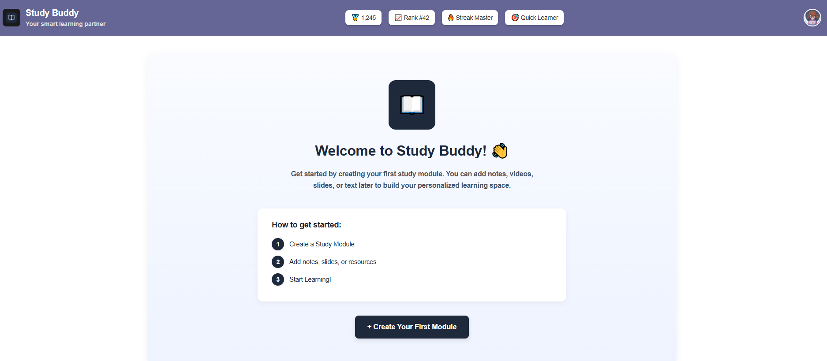
Dashboard (Logged in)

Slide 18
Module Selector
Notes:
Active and archived modules

Slide 19

Any Questions?

Slide 20
References
https://logolab.app
https://attentioninsight.com/
https://www.damiantgordon.com/EducationalModels/CriticalThinking/SOLO/
https://www.damiantgordon.com/EducationalModels/CriticalThinking/BloomsTaxonomy/index.html
https://www.ardentlearning.com/blog/what-is-the-kirkpatrick-model

